Slide 1

Fraud Detection
Nicholas Catani
ISM-6331

Slide 2
Content
What is it?
Threats in Banking
Machine Learning & others
Training
Challenges

Slide 3

What it is?
It a process to identify and prevent fraudsters from obtaining money or property through false means.

Slide 4
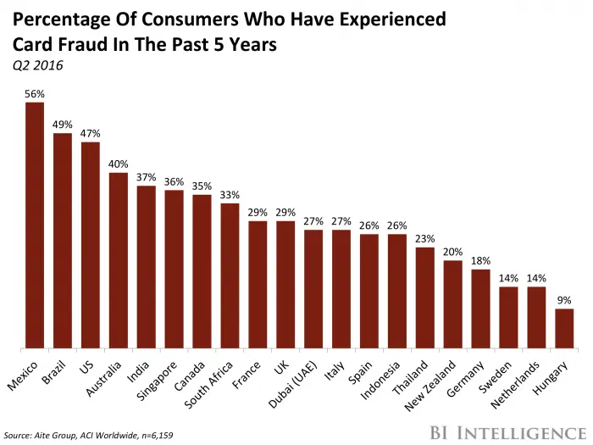

Slide 5
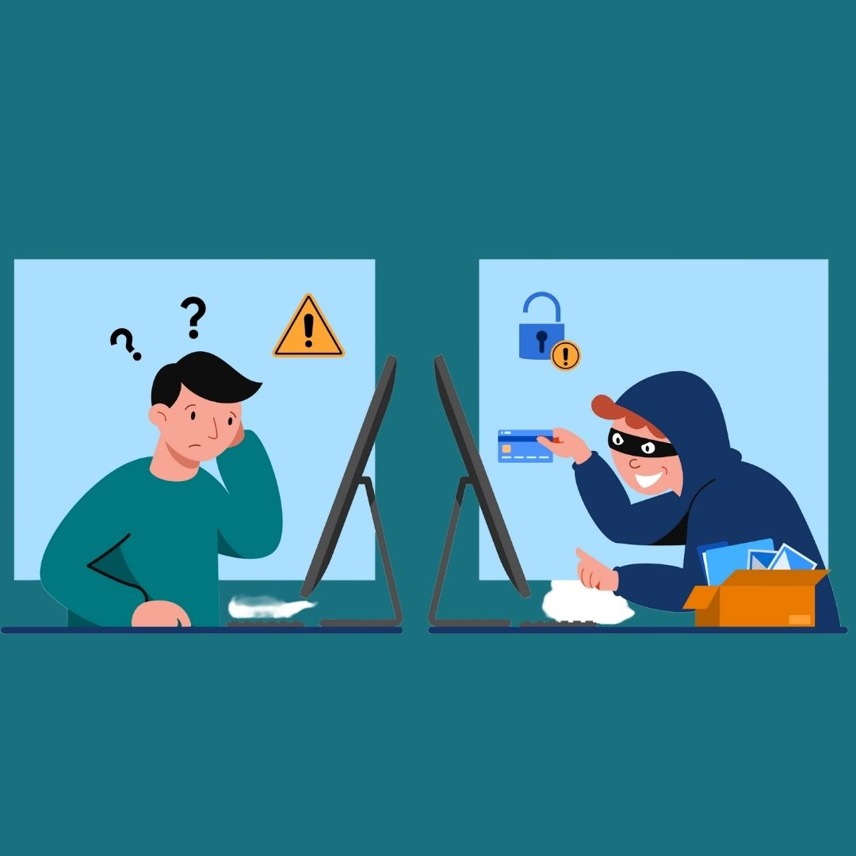
Threats in Banking
PHISHING ATTACKS
SPOOFING
RANSOMWARE
TROJAN
IDENTITY THEFT

Slide 6
ML & others
Machine Learning
Network Security Surveillance
Risk Management
Software Security
Protecting Critical Systems
Wide-area network connections help avoid attacks on massive systems. Plus, it monitors all programs and performs security checks on users, servers, and the VPN.
it is a perpetual network scanning to detect signs of dangerous or intrusive behavior. Frequently employed with firewalls, antiviruses, or IDS (intrusion detection systems). Generally, it allows for either manual or automatic scanning.
Safeguard apps are essential to business operations. They possess features such as helping synchronize security policies with file-sharing permissions and multi-factor authentication.
Data integrity, data security, security awareness training, and risk analysis, are all part of the package.

Slide 7
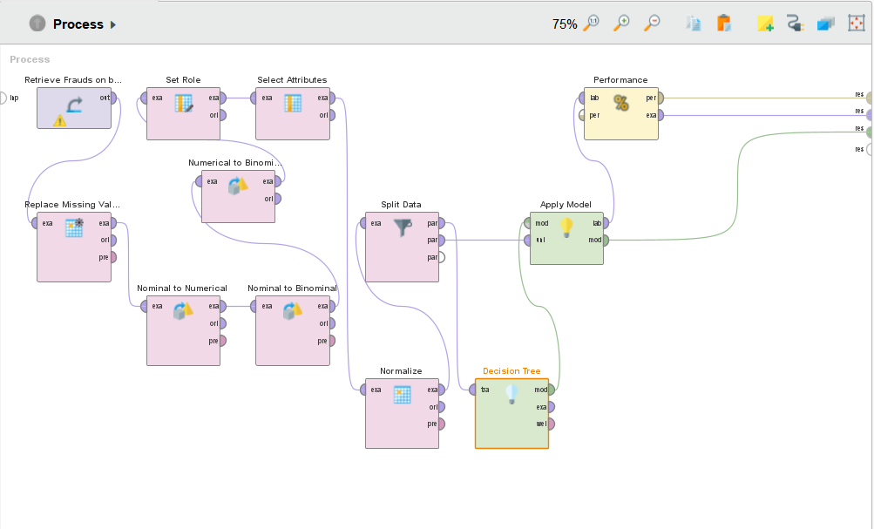
Training

Slide 8
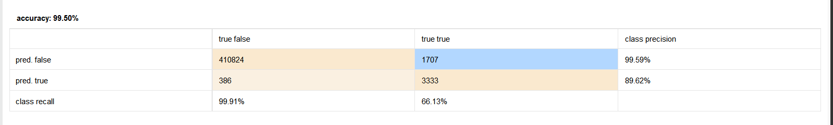
Confusion Matrix

Slide 9

Challenges
Lack of Knowledge
Tight Budget
Poor Mgmt.
Smartphones & Apps
Social Media

